Slide 1



Zomato

Slide 2
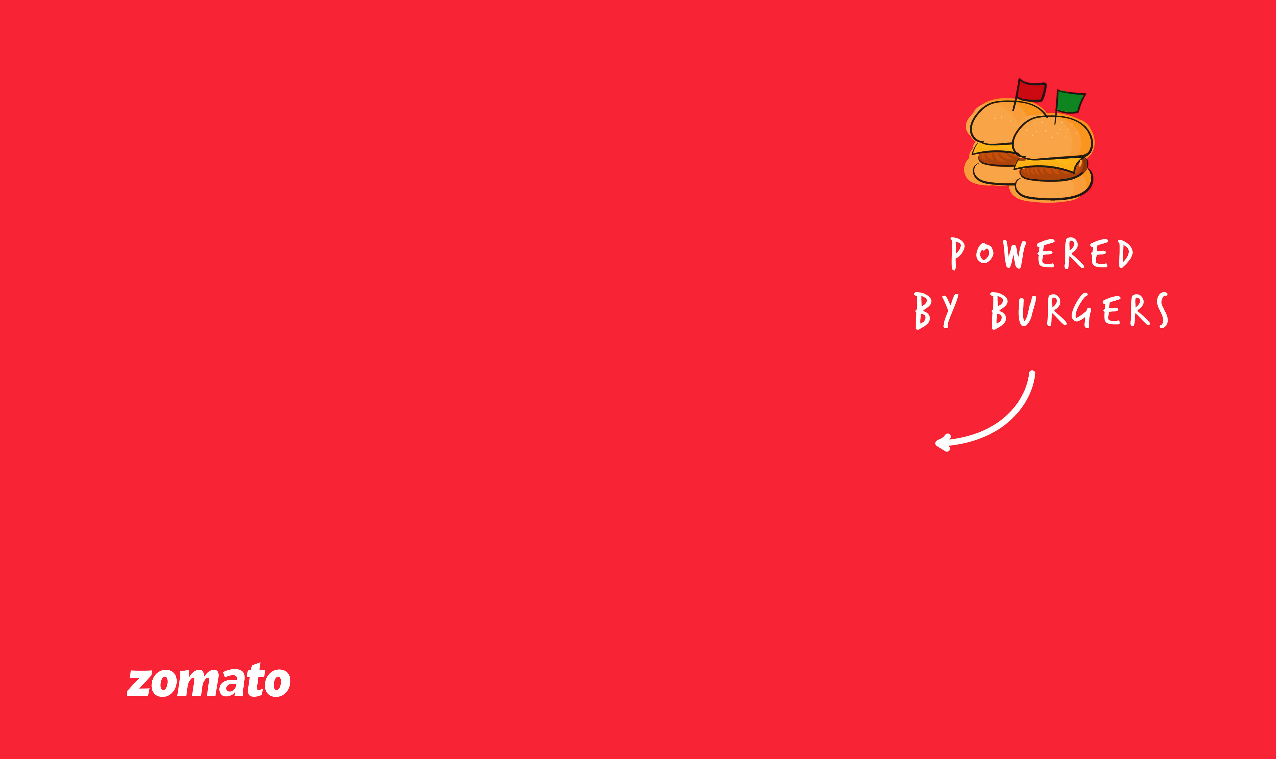
Group -3
VIKAS CHAUHAN
PRAVEEN SOBANAD
DARSHAN P HIDAKAL
ATHARV NILKANTH BUDHE
MANJUNATH BADIGER

Slide 3
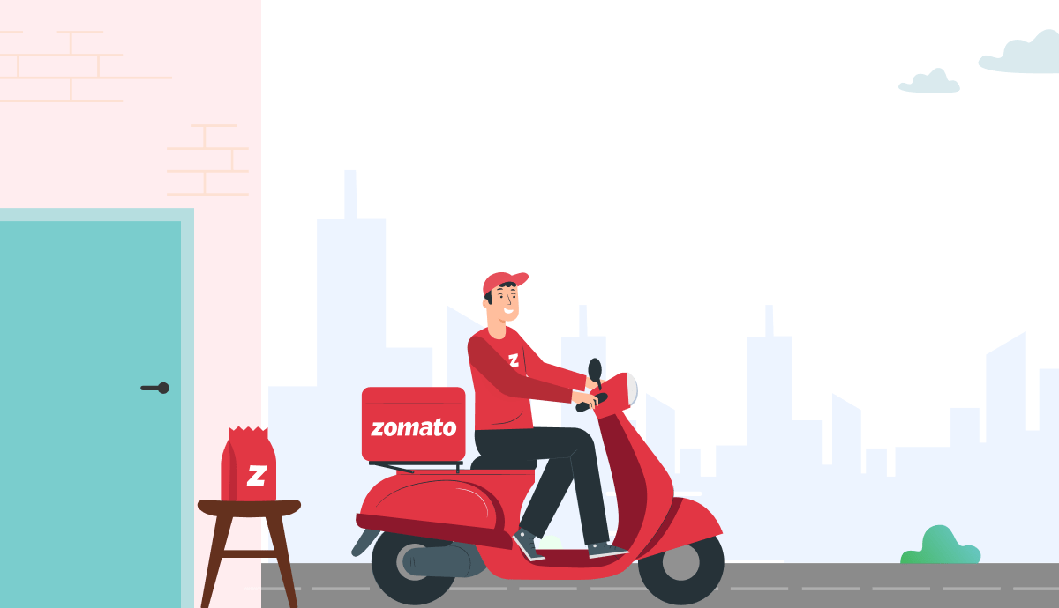
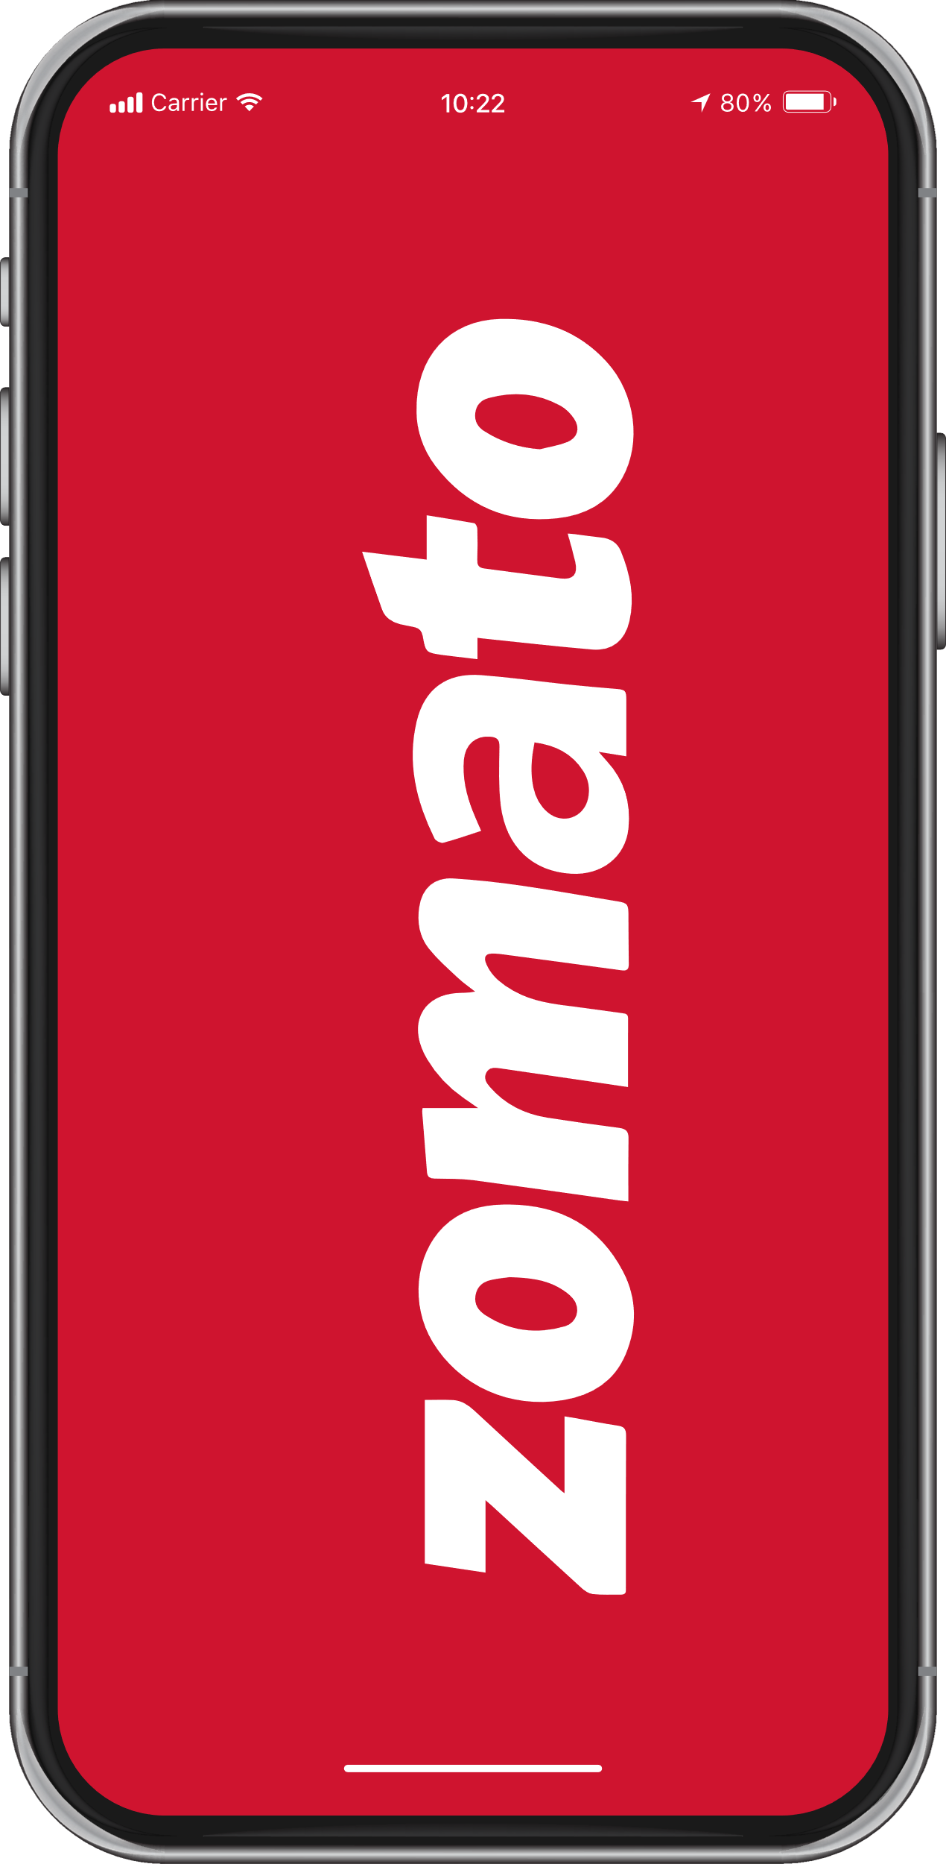
Zomato Company Outline
Started in – July 2008, Delhi
Founded By : Deepinder Goyal, Pankaj
Initial Name : “Foodie Bay”
Renamed as ‘Zomato’ in November 2010
Target Group : All Smartphone Users
Category – Mobile Application Based
Segment : Young Population, working professionals & market research companies
Sector : Food & Restaurant

Slide 4
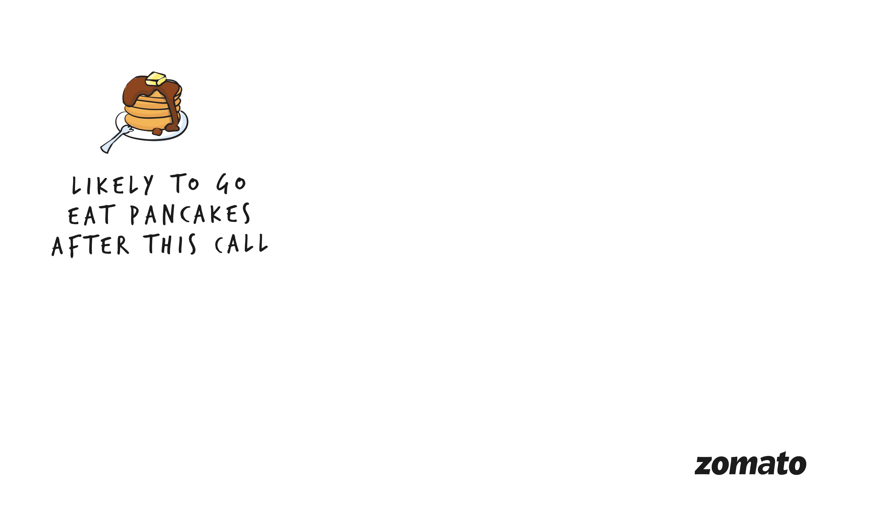
Zomato- Introduction
Zomato is a leading online food delivery platform.
It connects customers with restaurants in various cities.
Offers a wide range of cuisines and dishes to choose from.
Provides restaurant listings, reviews, and ratings
Available in multiple countries and cities

Slide 5


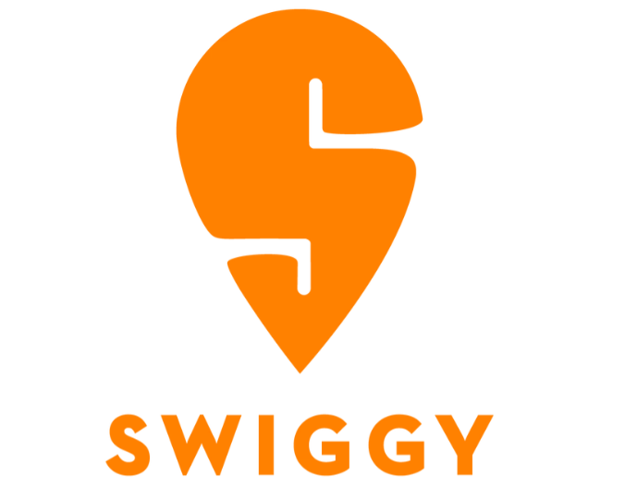


Zomato- Competitors
These are just a few of the prominent competitors that Zomato faces. The food delivery industry is highly competitive, and new players are constantly emerging. Zomato must continue to innovate and adapt to maintain its market position.

Slide 6

Zomato-How Zomato Stands Out
Extensive Global Reach: Zomato operates in numerous countries, offering a vast selection of restaurants.
In-Depth Restaurant Information: Detailed profiles, menus, and user reviews provide comprehensive insights.
Zomato Gold: Exclusive membership benefits and discounts for members.
Catering to a niche market: Zomato introduced a "Pure Veg Mode" to cater to vegetarian customers.
Personalized recommendations: Zomato's app uses AI-based algorithms to provide personalized recommendations to customers.
Innovative technology: Zomato has invested in mapping technology to track the location of customers and delivery partners, and in a drone-based delivery system.
Social media: Zomato's social media presence is known for its wit, clever memes, and food anecdotes. Zomato has also used reverse psychology to engage with its audience, such as when it tweeted asking people to order less and eat home-cooked food.

Slide 7
Problem Statement
1. What are the overall sales trends for Zomato?
2. Which cuisines, restaurants, or dishes are driving sales, and which are underperforming?
3. Are there specific regions or demographics where Zomato's sales performance could be improved?
4. What are the most popular cuisines and dishes on the Zomato platform, and how can this information be leveraged to enhance sales?
By addressing these questions through a comprehensive sales analysis, Zomato can gain valuable insights into its business operations, identify areas for improvement, and make data-driven decisions to achieve sustainable growth and success

Slide 8
Methodology
Data Collection and Pre-processing
Data Cleaning:
Deleting redundant columns.
Renaming the columns.
Dropping duplicates.
Cleaning individual columns.
Remove the NA values from the dataset.
Visualization Tools
Excel
Power BI,
Tableau for visualizing data and findings.
Data Management: Use SQL for efficient data querying and management throughout the analysis process

Slide 9
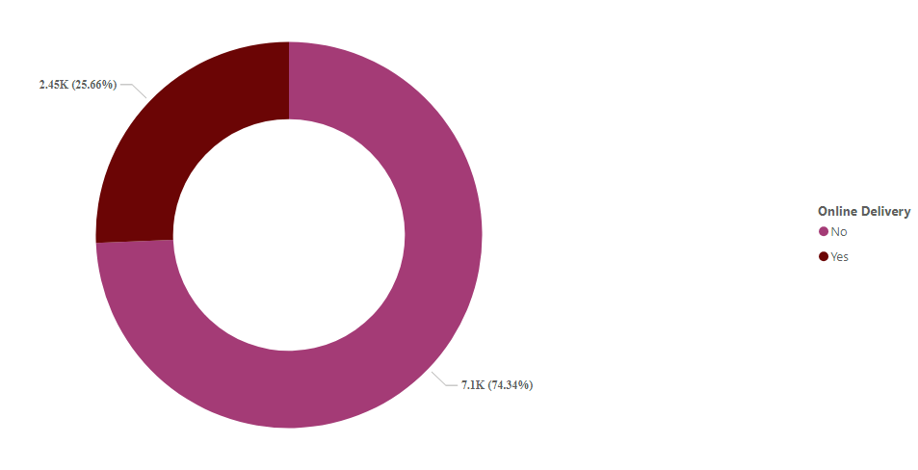
Number Of restaurants with online delivery
Only 2,450 (25.66%) offer convenient online delivery services. This means that nearly three-quarters of the listed restaurants do not currently provide this option.
Online delivery should be increased by promoting delivery services as it increases the sales volume brings more revenue.

Slide 10
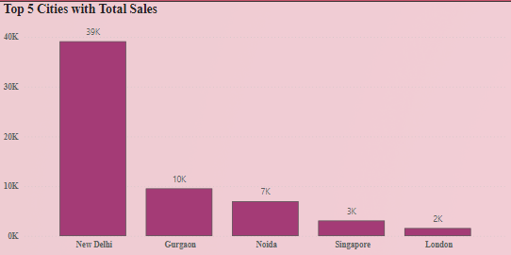
Top 5 cities with Total Sales
New Delhi Dominates Total Sales: New Delhi is the clear leader in terms of total sales, significantly outperforming the other cities.
Gurgaon and Noida Show Significant Sales: Gurgaon and Noida also demonstrate substantial sales volumes, indicating a strong market presence in these regions.
Conduct a more in-depth analysis of the Singapore and London markets to identify factors contributing to their lower sales performance. This could include understanding local preferences, competitive landscapes, or economic conditions.

Slide 11
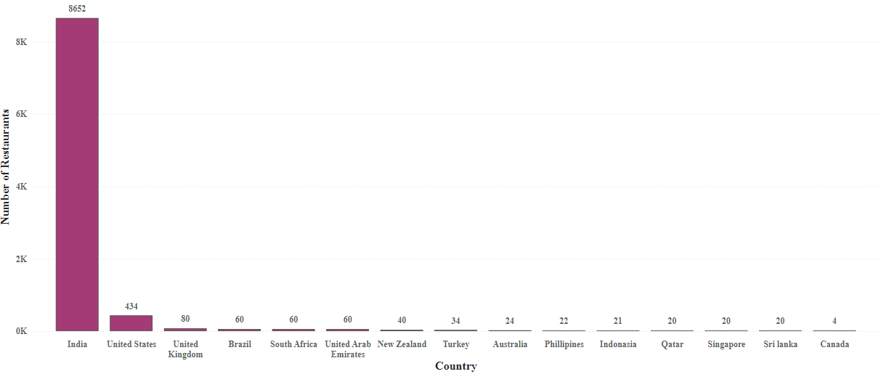
Number of restaurants by Country
Zomato dominates the restaurant listing market in India, with a significantly higher number of restaurants listed compared to other countries. This dominance is likely due to factors such as the country's large population, growing food delivery industry, and Zomato's early entry into the Indian market.
Zomato should expand restaurants partnership to increase sales where its earning potential is good. Expanding restaurants in US and UK will be better option as there is a good growth for sales compared to other countries.
Restaurants in Country Canada should be given special attention since they re performing poor.

Slide 12
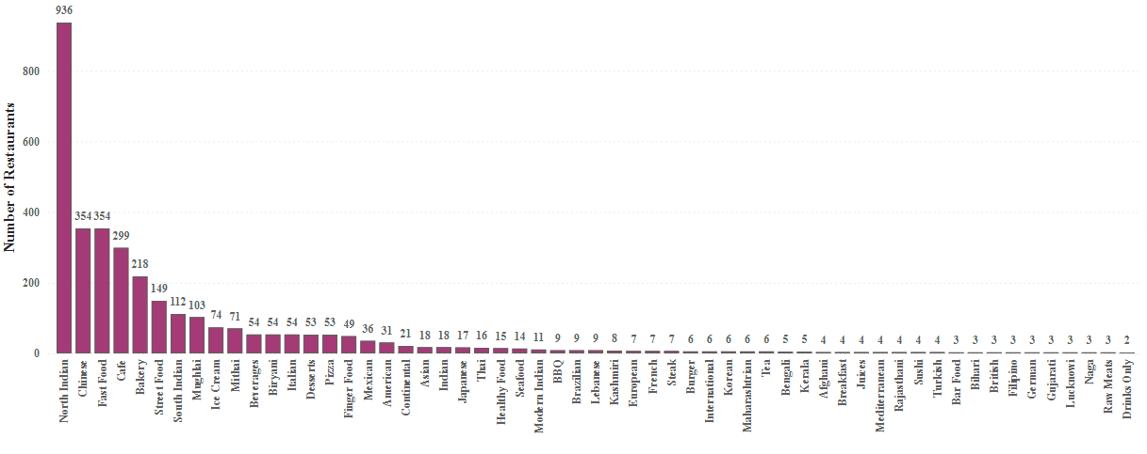
Number of restaurants by cuisines
North Indian cuisine is the most popular with a significantly higher number of restaurants compared to other cuisines.
Chinese and Fast Food cuisines also have a strong presence, indicating a preference for these options among consumers.
By analysing these factors, restaurants can make informed decisions about their menu offerings, target specific customer segments, and stay competitive in the evolving food industry.

Slide 13
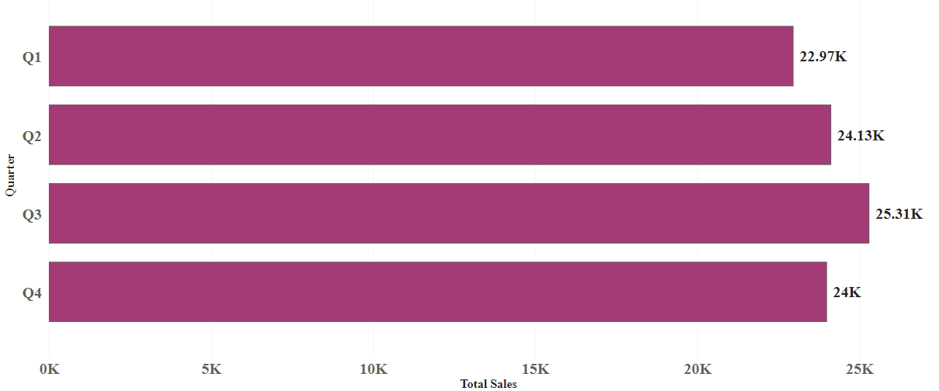
Total Sales by Quarter
Q3 Peak: Quarter 3 experienced the highest sales, potentially due to factors like increased consumer spending, favourable weather conditions, or seasonal promotions.
By analysing these factors, Zomato can make informed decisions about its marketing strategies, product offerings, and operational planning to drive continued growth and success.

Slide 14
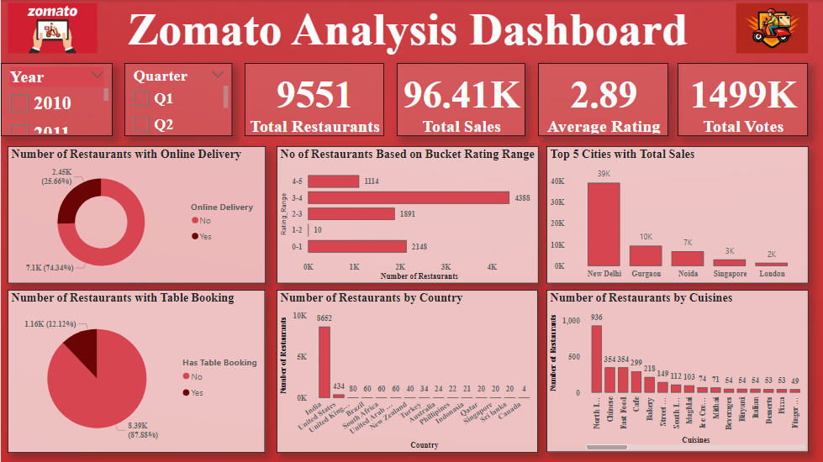

Slide 15
Conclusion
Zomato has demonstrated significant growth and success in the food delivery industry. The platform's vast network of 9,551 restaurants and total revenue of 96,41K through customer orders highlight its strong market presence and customer base.
Zomato's strong performance positions it well for continued growth and expansion. By focusing on factors such as enhancing customer satisfaction, optimizing operations, and exploring new market opportunities, Zomato can further solidify its market leadership and drive long-term success.
It was possible to provide valuable information to Zomato users for selecting the best restaurants, especially new ones. Additionally, new establishments could use this analysis to make informed decisions and develop effective business strategies.

Slide 16


